Slide 1
Impact of COVID-19 Employment Changes on Equity Risk Premiums

Slide 2



The Team
Mayur Deshmukh
I am here because I “love” to give presentations
Ahmed Tariq
Sentient potato.
David Marquez
I’m handsome, and I hope my data looks half as good as I do.

Slide 3
Past work related to the study
Income and Poverty in the COVID-19 Pandemic
HAN, J., MEYER, B. D., & SULLIVAN, J. X. (2020). Income and Poverty in the COVID-19 Pandemic. Brookings Papers on Economic Activity, 85–118. https://www.jstor.org/stable/26996637
The Unequal Inequality Impact of the COVID-19 Pandemic
DARVAS, Z. (2021). THE UNEQUAL INEQUALITY IMPACT OF THE COVID-19 PANDEMIC. Bruegel. http://www.jstor.org/stable/resrep32250
Impact of COVID-19 on Global Stock Market Volatility
Kusumahadi, T. A., & Permana, F. C. (2021). Impact of COVID-19 on Global Stock Market Volatility. Journal of Economic Integration, 36(1), 20–45. https://www.jstor.org/stable/26985574
Employment recovery in the wake of the COVID-19 pandemic
Handwerker, E. W., Meyer, P. B., Piacentini, J., Schultz, M., & Sveikauskas, L. (2020). Employment recovery in the wake of the COVID-19 pandemic. Monthly Labor Review, 1–24. https://www.jstor.org/stable/26976378
Firms around the World during the COVID-19 Pandemic
Waldkirch, A. (2021). Firms around the World during the COVID-19 Pandemic. Journal of Economic Integration, 36(1), 3–19. https://www.jstor.org/stable/26985573

Slide 4
Research
Questions
What is the effect that changes in employment due to COVID-19 had on global stock markets?
Which recovery metrics are the most related to stock market performance?
What data based approach can investors use to effectively allocate their money during future times of adversity?

Slide 5
DataSets
Data comes from:
Kaggle (Unemployment data)
OurWorldInData (Vaccination data)
Yahoo Finance (Stock market index data 1998-present)

Slide 6
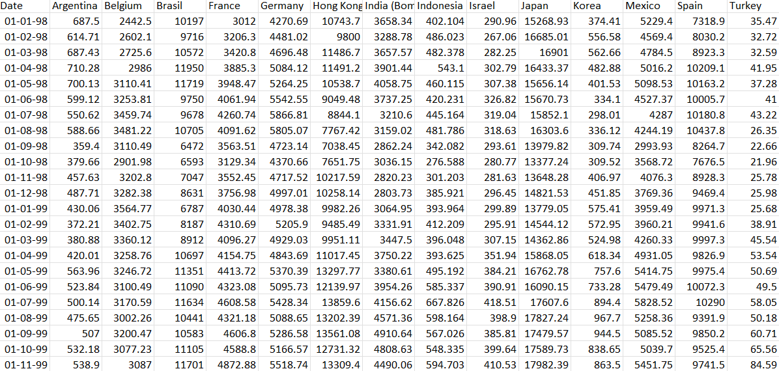
OK… let’s do the basics, what is the data all about?
17 different global stock market indexes
Unemployment rates from those 17 different countries
Development indexes from these countries.
Vaccination rates
Employment mobility

Slide 7
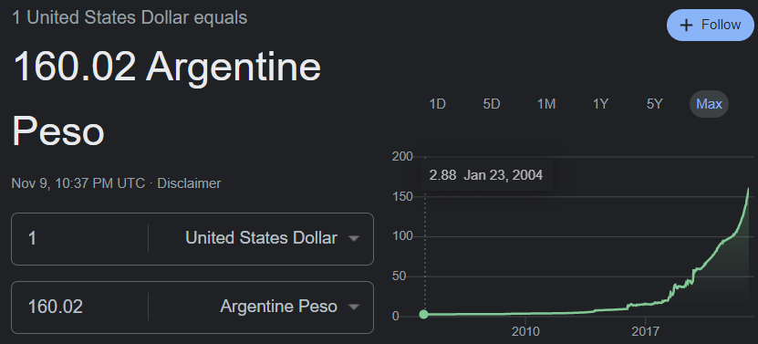
What was missing?
US Dollar Conversion rates (countries with high inflation are misrepresented in some cases).
Historical data can be spotty.

Slide 8
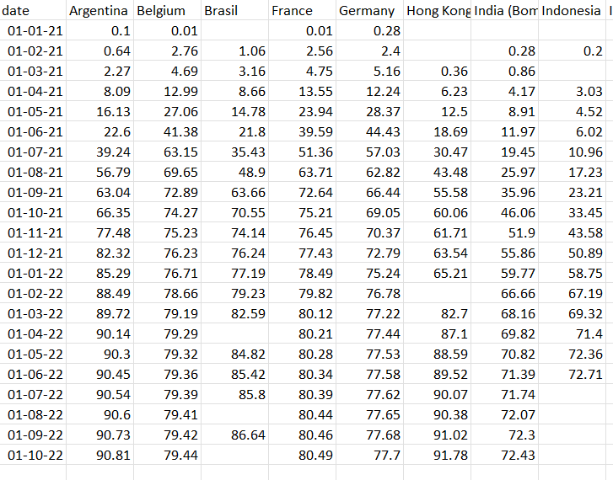
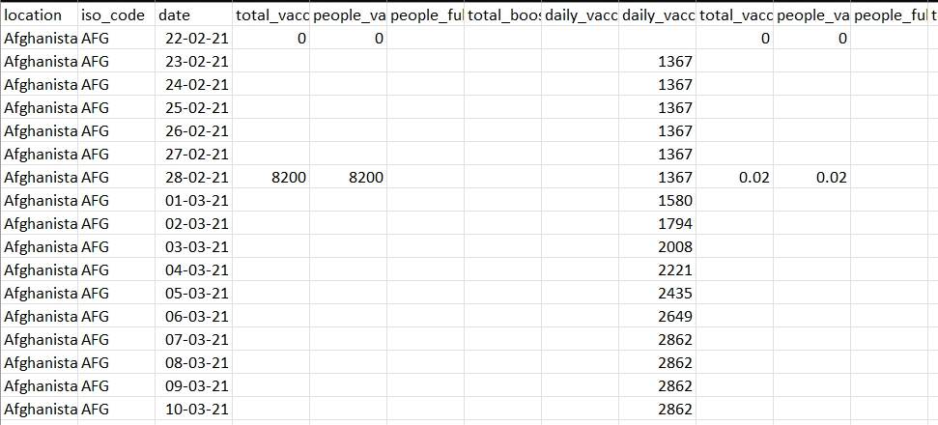
And we sure had to reformat
This
To This

Slide 9
Let’s Talk About Stocks
And not mention crypto.

Slide 10
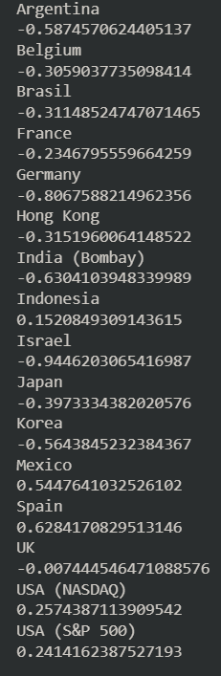
How Correlated Are They To Unemployment?
They’re somewhat correlated
Most stock markets rise as unemployment lowers (thus the negative correlation), with a few notable exceptions.

Slide 11
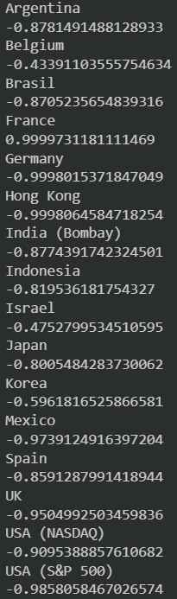
But if we take 2019-2021
The Numbers Speak For Themselves
A moderate correlation now becomes a nearly 1:1 ratio for most cases.

Slide 12
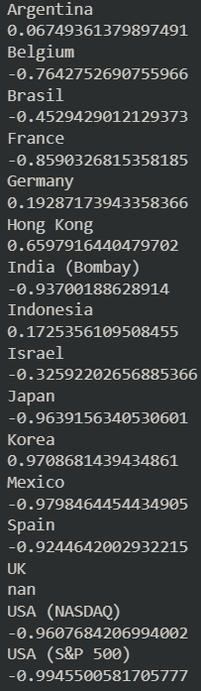
And it is present, but not as drastic during other recessions
Take the 2007-08 recession, for example. The correlations are present but not as strong in many cases.
Some exceptions applied too. Developing nations did better while other nations struggled.

Slide 13
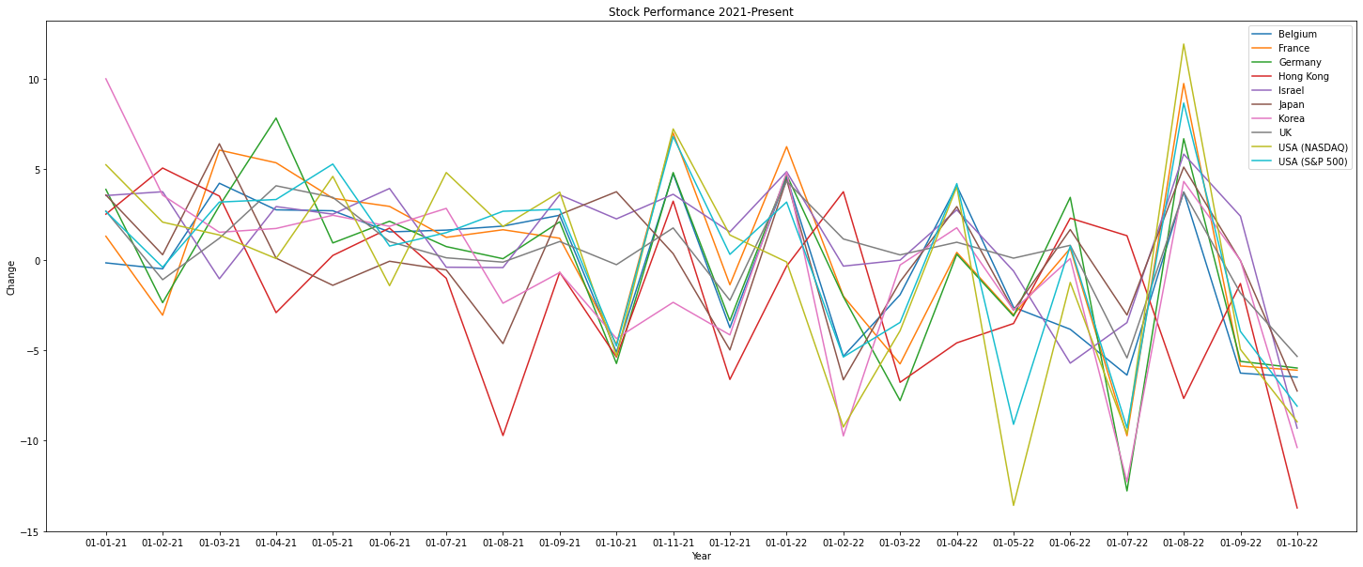
Turns Out Quick Vaccination Didn’t Do Much

Slide 14
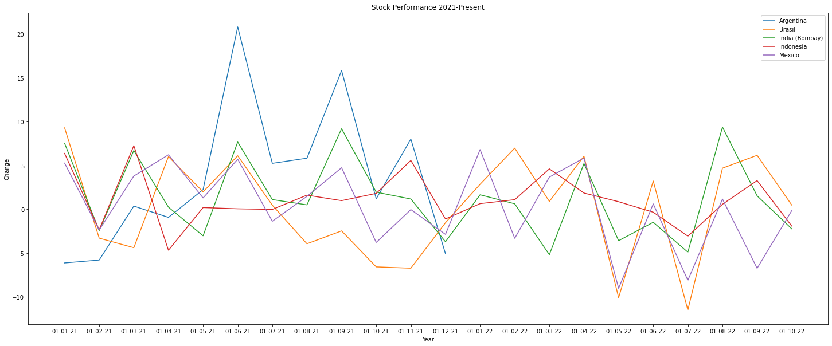
In Fact, Emerging Markets Did Slightly Better

Slide 15
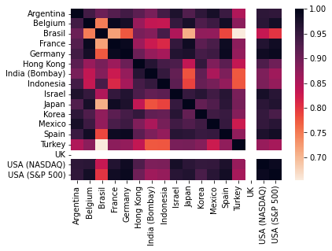
But how related are stock markets to each other?
Somewhat
A good chunk of them follow US stock markets closely during normal times.
Pictured: Global stock market correlations 1998-2021.

Slide 16
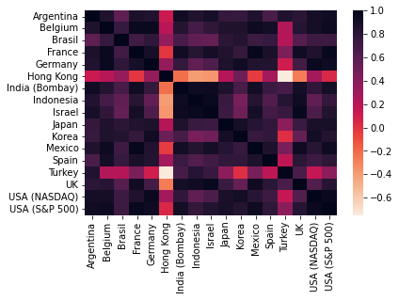
This Holds Up During COVID as well
From March 2020 to Oct 2022 most global stock markets moved in tandem with the USA. With the exception of Hong Kong, Turkey, and to a lesser extent other developing countries.

Slide 17
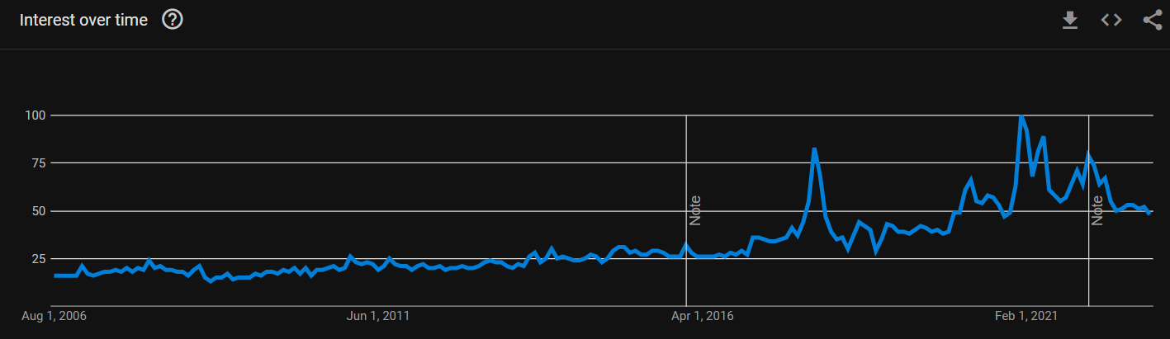
So what’s new?
Google Trends!
Tracking the term “How To Invest” Worldwide

Slide 18
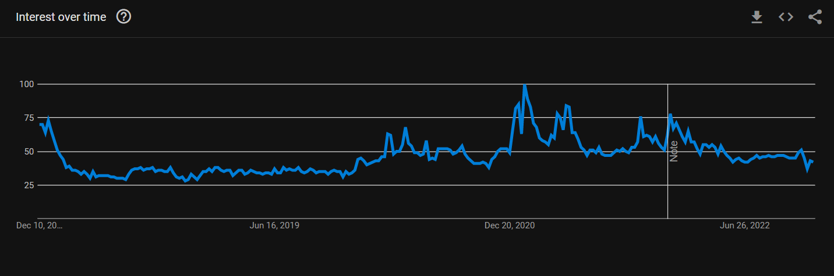
In Fact Let’s Zoom In

Slide 19
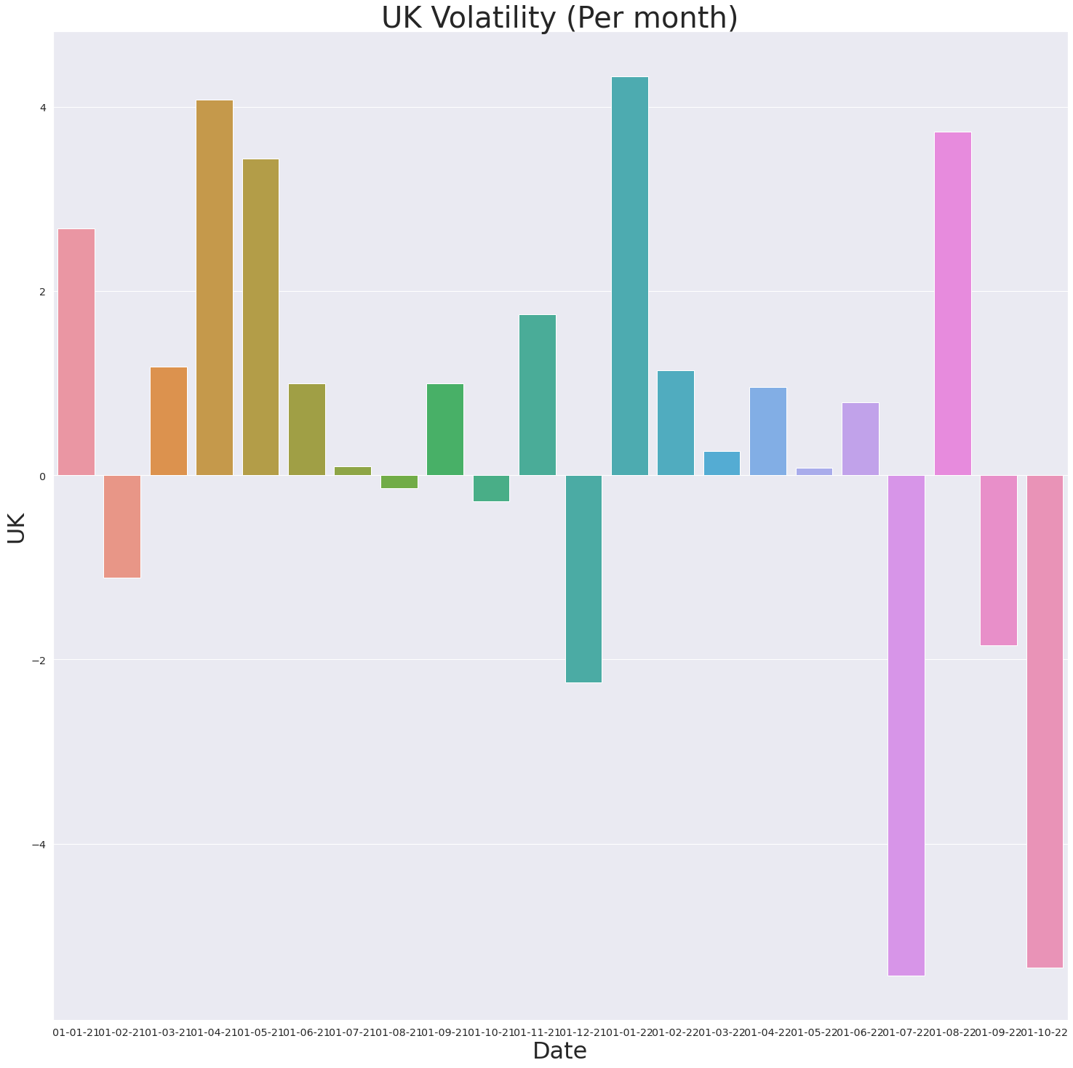
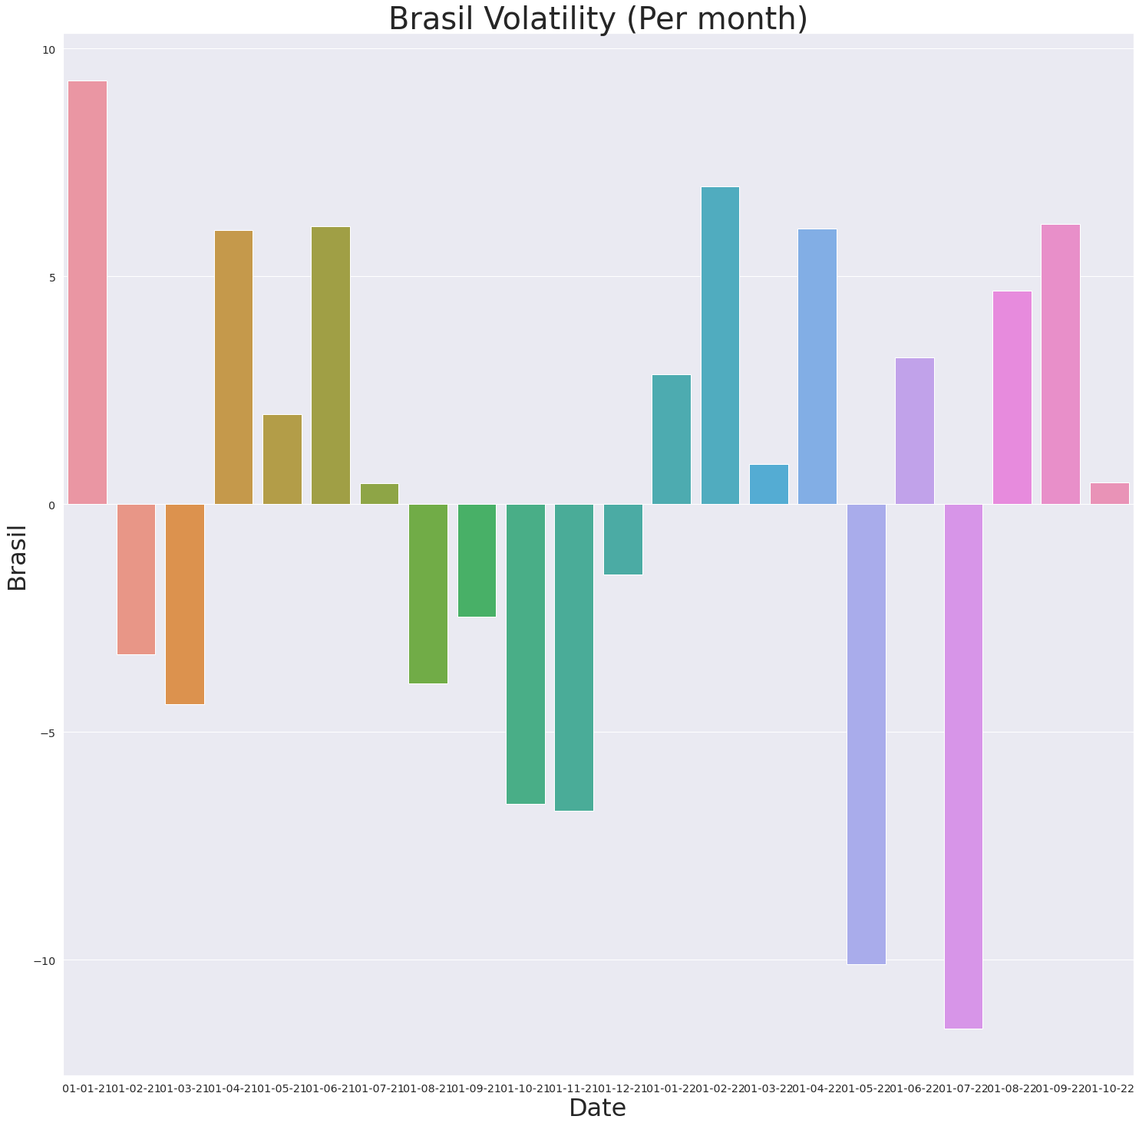
And Volatility!

Slide 20
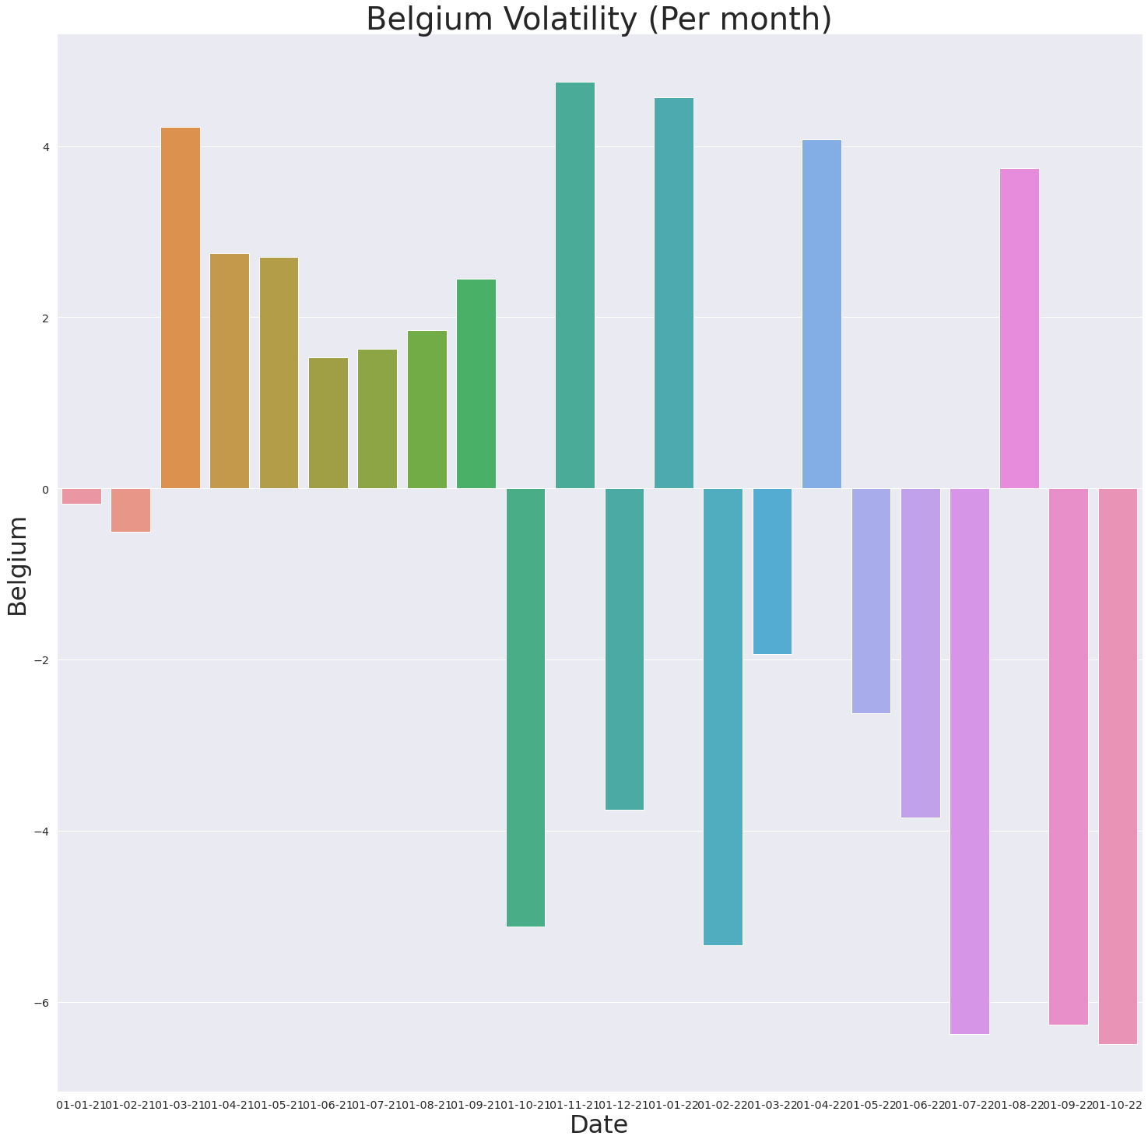
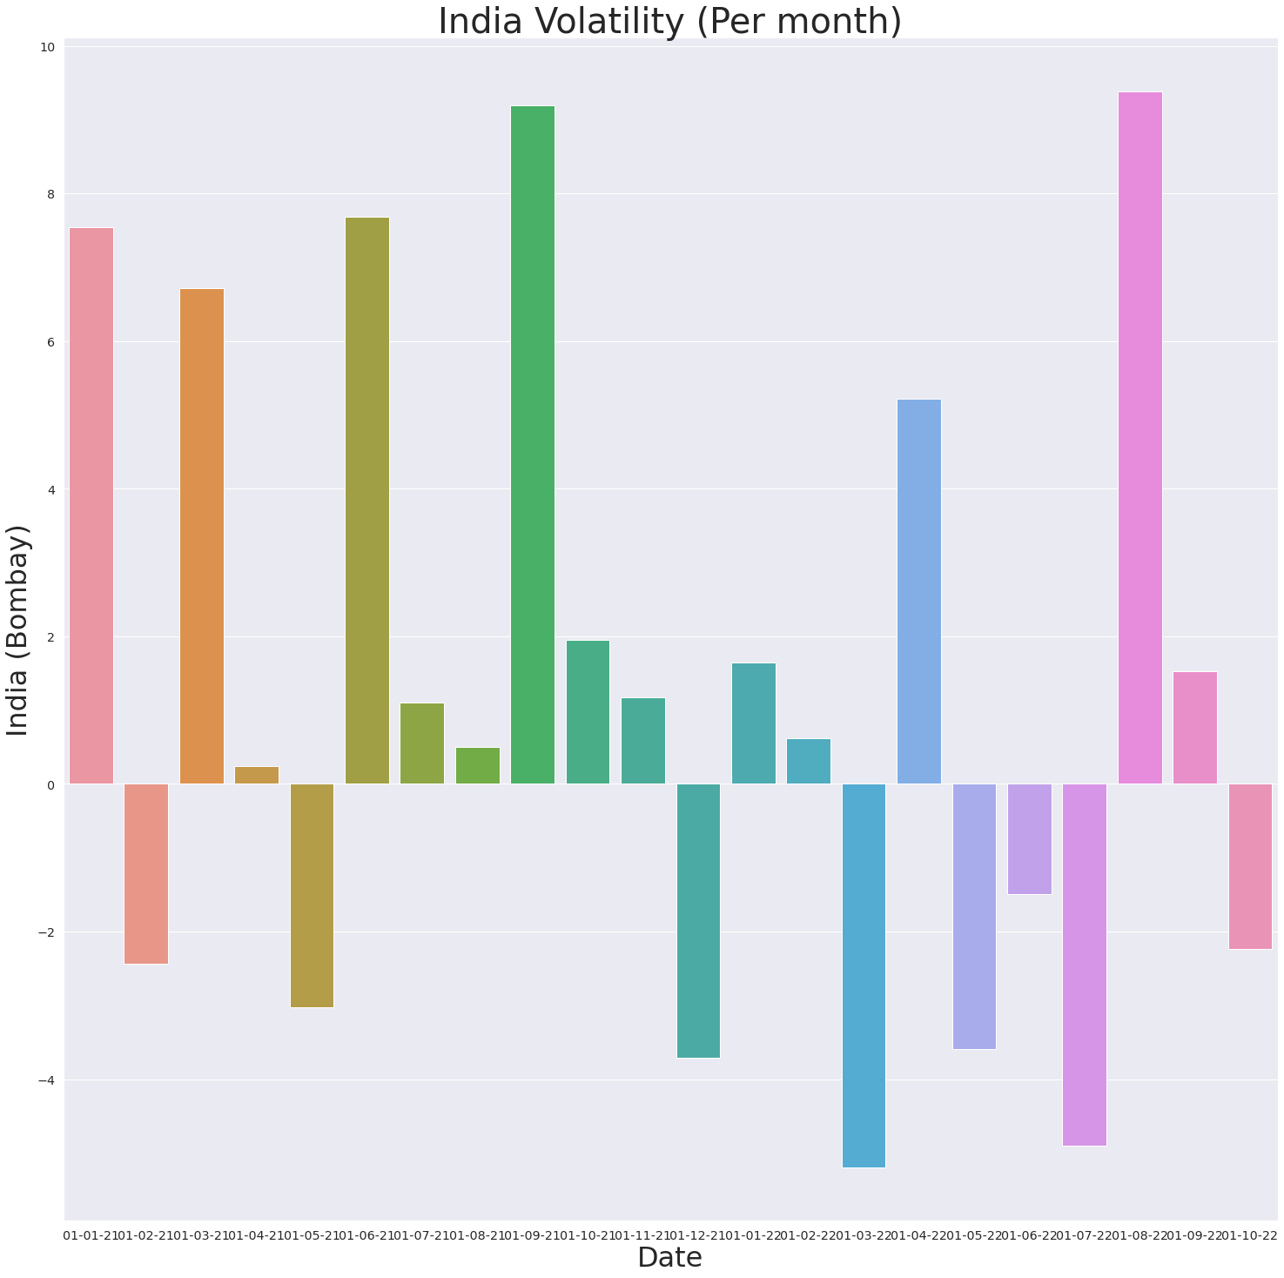
And Volatility!

Slide 21
Final Inferences
Emerging markets are the places where you can most often find uncorrelated returns.
Note: Uncorrelated does NOT imply positive returns, just different returns.

Slide 22
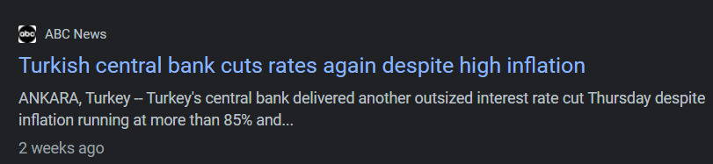
Final Inferences (cont.)
Efficient market hypothesis:
“asset prices reflect all available information”
There is less available information in emerging markets. Thus markets are more prone to react differently to imperfect information.

Slide 23
Final Inferences (For real now)
However, uncorrelated assets may become correlated in heavy times of crisis.
And exceptions are not often positive.

Slide 24

Thank you! Be safe, and happy investing!

Slide 25

Thank You Devansh!

